Slide 1
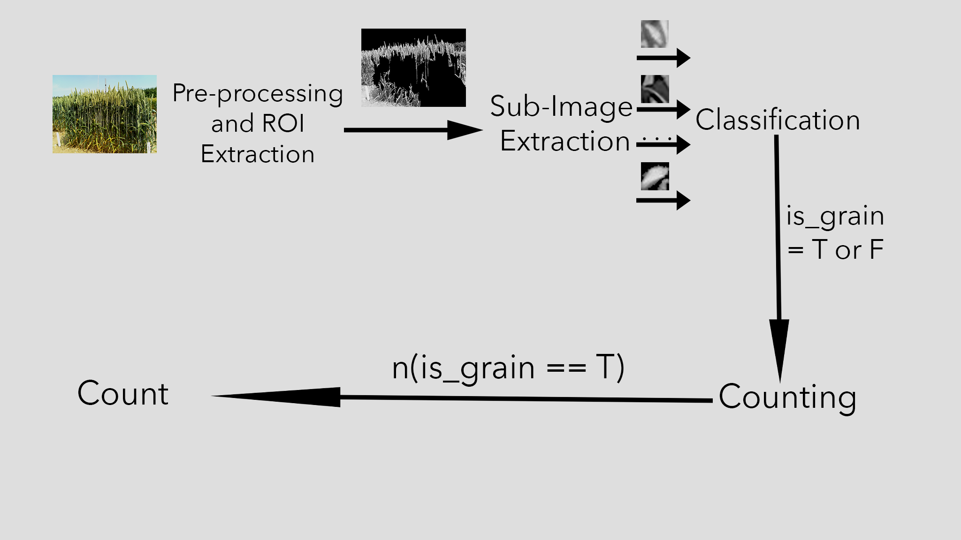
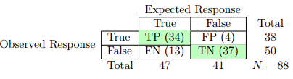
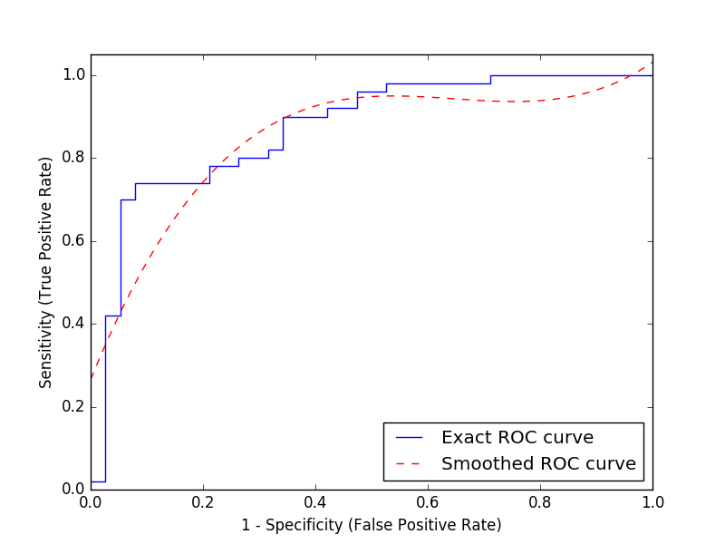
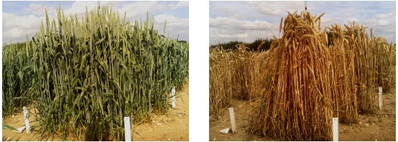
Automated Counting of Wheat Grains in Images
Student: Odie Edo-Osagie, Supervisor: Wenjia Wang
School of Computing Sciences, August 2016
Aim and Objectives
This study developed machine learning based algorithms to analyse images and produce a count of the number of wheat grains in the images with the following as objectives:
To highlight and segment grain regions
To count the number of grains in the segmented regions
Methods
Counting-by-detection: This approach aims to detect all instances of grains in a given image, then compute the count as the number of instances detected
Experiment Results
The classification accuracy of the convolutional neural network was assessed and an ROC curve was plotted.
Data
Images of wheat plants at different stages of development and in different orientations were provided by the John Innes Centre (JIC).
Fig 1. Examples of images from dataset
Figure 2. The pipeline of the counting framework.
System Design
The system first pre-processes the image, extracting the regions of interest (i.e. Grain regions).
It then breaks the image into thousands of sub-images.
The sub-images are passed to a convolutional neural network which has been trained and predicts whether a sub-image contains a grain or not.
The number of sub-images classified as containing a grain is returned as the count.
Fig 3. Confusion matrix and ROC curve for grain detection
Conclusions
The framework was found to detect grains with an accuracy of 80%. It did this with 71% sensitivity and 90% specificity and outperformed the other methods including counting by regression
MSc Dissertation 2015-16
MSc Course: Advanced Computing

